Slide 1
UE17CS490B – Capstone Project Phase – 2
Project Progress Review #2
Project Title : Style Consistent Kannada Font Generation
Project ID : PW21KS04
Project Guide : Prof. K S Srinivas
Project Team : Saahil B Jain - PES1201700241
Jeevana R Hegde - PES1201700633

Slide 2
Outline
Abstract and Scope of the Project.
Approach & Design Description.
Project Progress and Demonstration.
Timeline for Pending Tasks.
Conclusion.
References.

Slide 3
Abstract and Scope
Problem statement:
The project is to automate the generation of new fonts for the Kannada scripts while taking inspiration from existing fonts from English language.

Slide 4
Abstract and Scope
Abstract:
Indian languages currently have a limited set of fonts available to choose from.
Creation or generation of new fonts is at present, a manual process.
This can tend to be a tedious, expensive and time-consuming process.
Our project goal initially was mainly to automate the generation of new fonts for the Kannada scripts while simultaneously ensuring generation of ಮಾತ್ರಗಳು (maatras) and ಒತ್ತಕ್ಷರಗಳು (otaksharas).
Our current objective leans towards taking inspiration from existing fonts from a language such an English which has an abundance of styles and inculcating these in creating new fonts for Kannada.
This is essentially Style-Transfer.

Slide 5
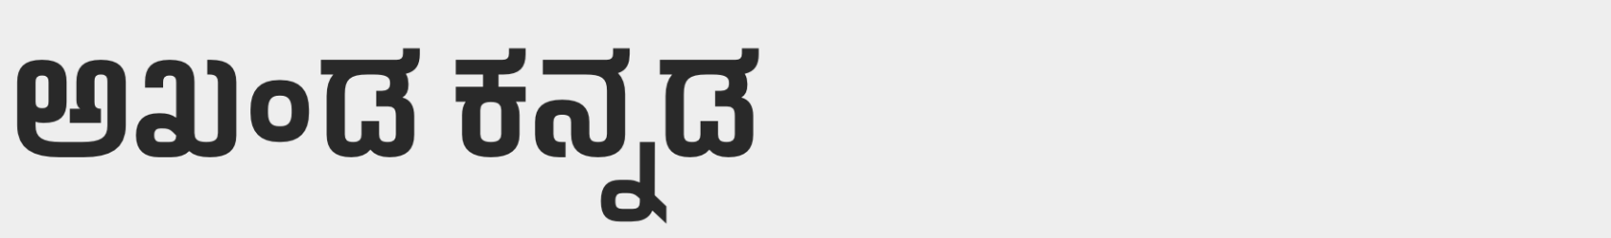


Abstract and Scope
Scope:
Indian Type Foundry (ITF) is a company which manually creates customized fonts for various languages.
The charges range from 26,000INR - 2,60,000INR for a specific typeface.

Slide 6
Abstract and Scope
Scope:
Currently font generation is done where the designers must manually draw and further trace Glyphs (characters) using software tools such as Font Developer.
For each font, the time varies from a couple of hours to a couple of days.
Our project aims to automate this process while simultaneously trying to incorporate style inspired from fonts available for other languages(Style transfer).
Hence makes the process less time-consuming, more efficient(using style consistency) and provides a varied set of options to choose from at a cheaper price.

Slide 7

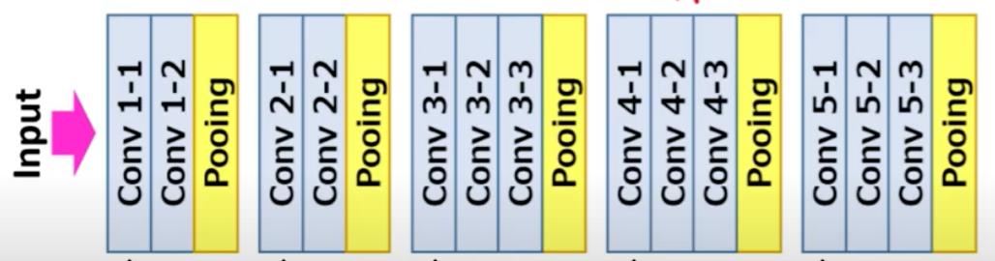
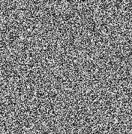

Proposed Approach / Methodology
1. Neural cellular architecture
Model architecture

Slide 8
Proposed Approach / Methodology
Basic approach
The inputs include the style image, target character and the generated image.
The three inputs are passed to the Neural network iteratively and the loss calculated is back propagated.
The output of each iteration is passed as input to the next iteration.
The process is repeated until the generated image is satisfactory.

Slide 9
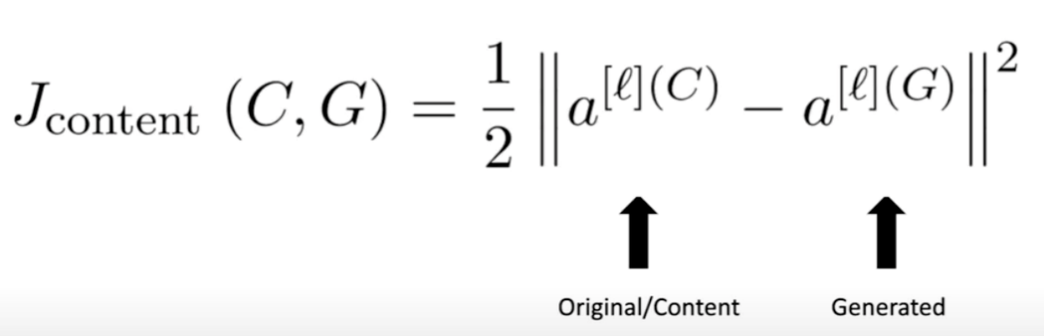
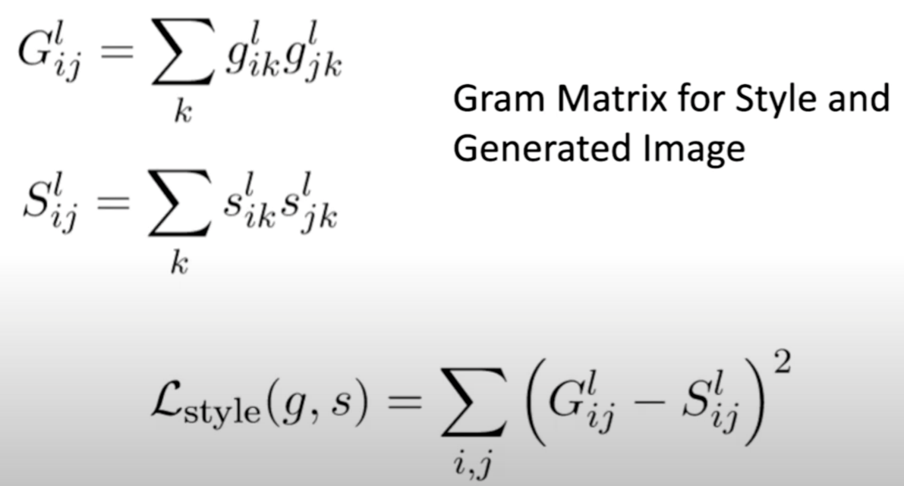
Proposed Approach / Methodology
Basic approach
Content loss
Style loss
Total loss

Slide 10

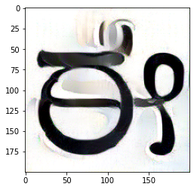

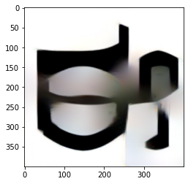
Proposed Approach / Methodology
Results obtained
Style 1
Result 1
Target image
Style 2
Result 2

Slide 11
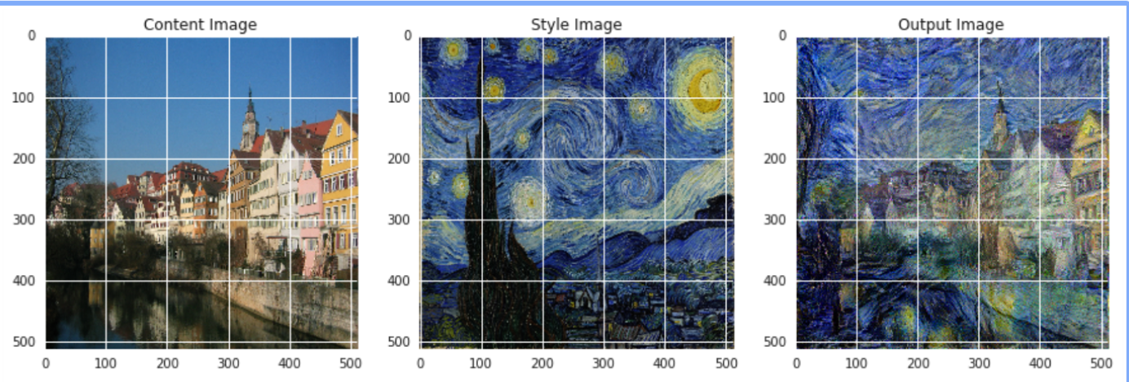
Proposed Approach / Methodology
Need for changing this approach

Slide 12
Proposed Approach / Methodology
Need for changing this approach
This approach works well on artistic style transfer.
The reason being, the style loss mentioned works well at identifying colour and structures.
In case of fonts, neither do we have colours nor do we want the same black structure of the input font.
This requires us to change the way in which style loss is calculated or try another approach as discussed further.

Slide 13
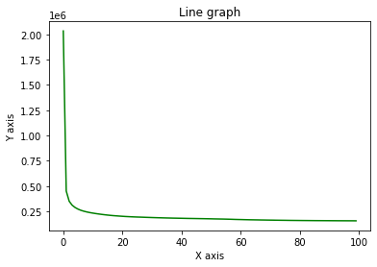
Proposed Approach / Methodology
Benefits
The results of the model improve on increasing the image size
Identifiable style transfer obtained
Drawbacks
Although the results of the model improve on increasing the image size, the generation time increases significantly.
The model outputs saturate after a few thousand iterations.
Each letter needs to be iteratively generated(1000).

Slide 14
Algorithm & Pseudocode
for gen_feature, orig_feature, style_feature in zip
(generated_features, original_img_features, style_features):
channel, height, width = gen_feature.shape
original_loss += torch.mean((gen_feature - orig_feature) ** 2)
# Compute Gram Matrix of generated
G = gen_feature.view(channel, height * width).mm(
gen_feature.view(channel, height * width).t()
)
# Compute Gram Matrix of Style
A = style_feature.view(channel, height * width).mm(
style_feature.view(channel, height * width).t()
)
style_loss += torch.mean((G - A) ** 2)
total_loss = alpha * original_loss + beta * style_loss

Slide 15
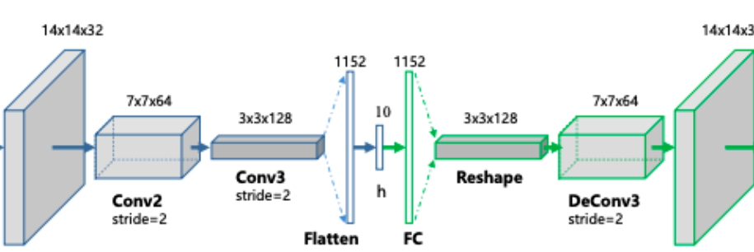


Proposed Approach / Methodology
2. Autoencoders
Model architecture

Slide 16
Proposed Approach / Methodology
Basic approach
The idea is to train an autoencoder which takes a character in basic font as input and converts it into the required font.
Currently, English letters of Screen Sans style are being taken as input images and the letters of the required font are taken as output images. Based on this the autoencoder is trained.
Later when Kannada letters are provided as inputs, the outputs obtained are expected to have the desired style.
Hence style transfer has been obtained.

Slide 17
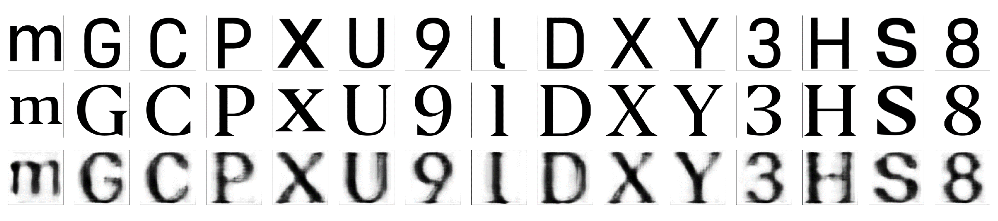

Proposed Approach / Methodology
Results
Train
Test

Slide 18
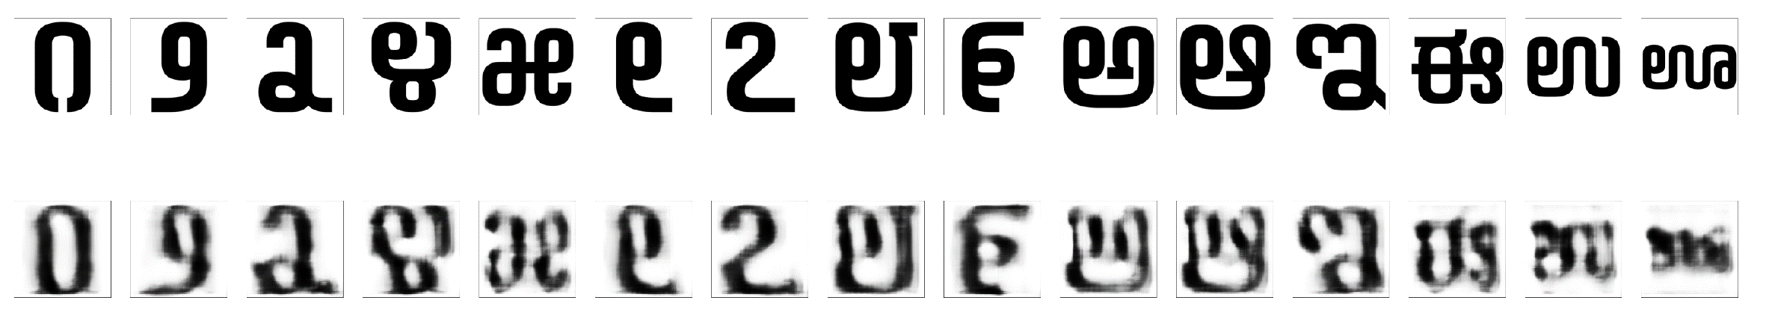
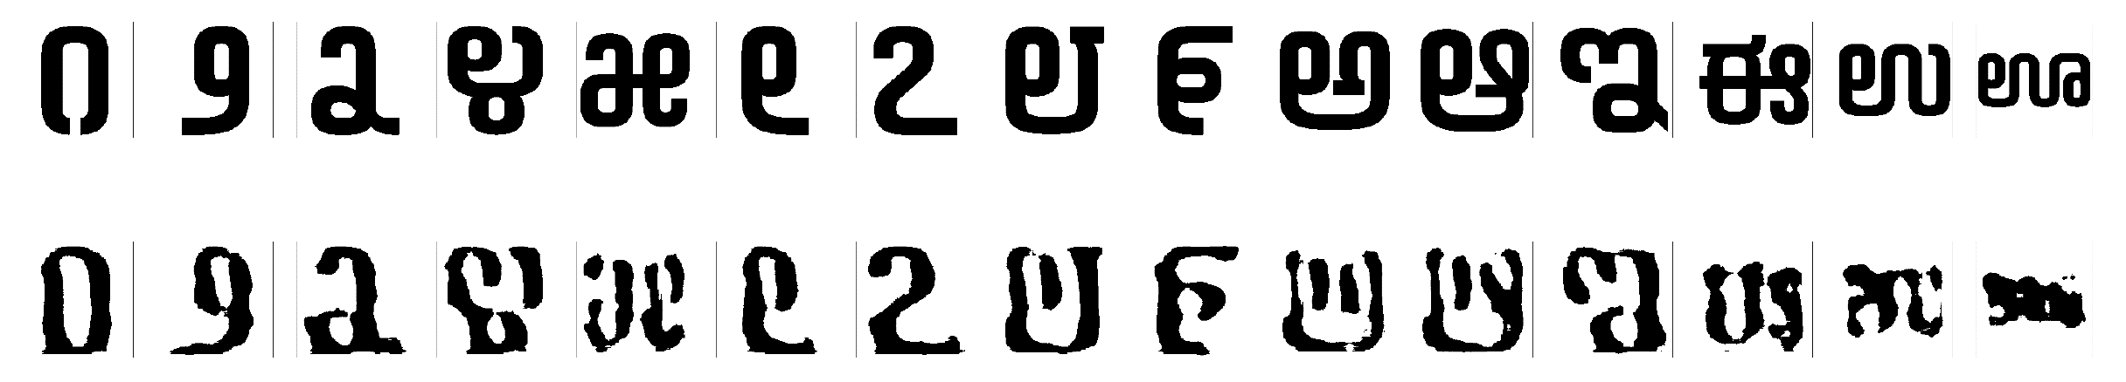
Proposed Approach / Methodology
Results
Kannada letters and digits:
Sharpened images:

Slide 19
Proposed Approach / Methodology
Benefits
Just a single trained autoencoder can be used to generate fonts for every character of Kannada language.
Models are comparatively smaller.
Generation is very quick.
Drawbacks
New model is required for each font.
English letters are not as detailed as Kannada fonts. Hence, style transfer currently results in removal of these details.
Creation of large labelled dataset is quite challenging.

Slide 20
Algorithm & Pseudocode
input_img = keras.Input(shape=(DIMS, DIMS, CHANELS))
size = len(layer_depths)
x = layers.Conv2D(8, (9, 9), activation='relu', padding='same')(input_img)
x = layers.MaxPooling2D((2, 2), padding='same')(x)
x = layers.Conv2D(8, (9, 9), activation='relu', padding='same')(input_img)
encoded = layers.MaxPooling2D((2, 2), padding='same')(x)
x = layers.Conv2D(8, (9, 9), activation='relu', padding='same')(encoded)
x = layers.UpSampling2D((2, 2))(x)
x = layers.Conv2D(8, (9, 9), activation='relu', padding='same')(encoded)
x = layers.UpSampling2D((2, 2))(x)
decoded = layers.Conv2D(CHANELS, (7, 7), activation='sigmoid', padding='same')(x)
autoencoder = keras.Model(input_img, decoded)
autoencoder.compile(optimizer='adam', loss='binary_crossentropy')

Slide 21
Project Progress So far
Progress:
Started off by obtaining datasets and cleaning them for the Kannada language.
From there, the initial stage was the generation of characters for the Kannada language. This has been fulfilled.
The maatras and otaksharas is also being generated.
Next came the inculcating style transfer. To begin with, we have obtained and cleaned the dataset of English letters and labelled them as per requirement.
We have successfully trained a basic model for the style transfer.
Percentage of completion of the project: 72%

Slide 22
Project Demonstration
DEMONSTRATION

Slide 23
Timeline – Update on Pending Tasks
1 WEEK | 3 WEEKS | FOLLOWING WEEKS
Extending data | Fine tuning(obtaining accurate loss function and training the model) | Documentation

Slide 24
Conclusion
The two approaches pursued provide decent results for English language.
However, have not successfully captured all the intricated details of the Kannada language.
Figuring out a loss function to capture the font styles is crucial for further enhancement of the obtained results.
We plan to develop our own loss function and test them to achieve the expected results.

Slide 25
References
Research Paper
[1] Samaneh Azadi, Matthew Fisher, Vladimir Kim, Zhaowen Wang, Eli Shechtman, Trevor Darrell, “Multi-Content GAN for Few-Shot Font Style Transfer”, Dec. 01, 2017. [Online]
Available: https://arxiv.org/pdf/2006.06676.pdf [Accessed Jan. 16,2021]
Research Paper
[2] Yonggyu Park, Junhyun Lee, Yookyung Koh, Inyeop Lee, Jinhyuk Lee, Jaewoo Kang, “Typeface Completion with Generative Adversarial Networks”, Dec. 13, 2018. [Online],
Available: https://arxiv.org/pdf/1811.03762.pdf [Accessed Jan. 05, 2020]

Slide 26
References
Research Paper
[3] Yizhi Wang, Peking University, “Attribute2Font”, May. 16, 2020. [Online],
Available: https://arxiv.org/pdf/2005.07865v1.pdf [Accessed Jan. 22, 2021]
Research Paper
[4] Leon A. Gatys, Alexander S. Ecker, Matthias Bathge, “A Neural Algorithm of Artistic Style”, Sep. 02, 2015. [Online],
Available: https://arxiv.org/pdf/1508.06576.pdf [Accessed Feb. 01, 2021]

Slide 27
Thank You

